Slide 1

Bundled Payments for Care Improvement Initiative– Continuity Assessment Record and Evaluation (B-CARE)
Version 1
B-CARE Briefing for Training Orientation
DATE/TIME

Slide 2
Agenda
Introduction to Econometrica/Master Trainers
Training and Support
Welcome Packet Information
Webinar Registration
Help Desk Information
Portal Access Registration Process
B-CARE Assessment Tool Technical Information
Closing

Slide 3
Introduction to Econometrica
CMS/CMMI selected Econometrica to assist you in implementing the B-CARE Tool at your facility. Econometrica is experienced in managing national health care improvement initiatives for the Federal Government as well as for the private sector. Our staff members are here to support your team with:
Planning for implementation of the B-CARE Tool.
Identifying ways to integrate B-CARE assessments into the daily workflow of your staff.
Providing initial and ongoing training to End Users of the B-CARE Tool.
Assisting you with tracking data submissions and interpreting reports on data quality, accuracy, and completeness.

Slide 4
Introduction to Econometrica
Flow of Information from CMS to the End User, through Econometrica.
CMS
Econometrica Team
Master Trainers
End User•
Enter Results Into Database
B-CARE Coordinators

Slide 5
Introduction to Master Trainers
Lynnette Pair Young Email: LYoung@EconometricaInc.com
Johnnetta Davis-Joyce Email: JJoyce@EconometricaInc.com
Monique Sheppard Email: MSheppard@EconometricaInc.com
Wendy Gary Email: WGary@EconometricaInc.com
Emily K. Grossman Email: EGrossman@EconometricaInc.com
Karine Mauprivez Email: KMauprivez@EconometricaInc.com
Nikitha Mohan Email: NMohan@EconometricaInc.com
Nancy Weller Email: NWeller@EconometricaInc.com

Slide 6
Training and Support: B-CARE Training Support
B-CARE Tool Training and Support
Training of B-CARE Coordinators and End Users
Technical Support: Master Trainers
Help Desk
Secure Web Portal

Slide 7

Training and Support: Econometrica Roles
Master Trainer
Function as subject matter experts (SMEs) for tools, processes, and project content around B-CARE Tool implementation and ongoing usage.
Orient, train, and provide continuing support to B-CARE Coordinators and to your facility.
Assist your B-CARE Coordinator(s) with interpreting reports as well as assist in developing and monitoring key strategies you may implement for improving data quality and/or completeness.
System Administrator/Help Desk
Liaison between the Baltimore Data Center (BDC) technical staff.
Design and develop software for patches and upgrades to the B-CARE application during future releases.
Responsible for off-site maintenance of the B-CARE Tool as requested by BDC staff
Maintain user access to include resetting passwords, deleting accounts, and approving new B-CARE Coordinators.

Slide 8
Training and Support: Awardee Roles
B-CARE Coordinator
Assists with coordinating and implementing B-CARE Tool.
Responsible for a variety of processes and quality tasks and for tracking completeness.
B-CARE End User
Clinical personnel.
Collects data from beneficiary and medical records.
Completes B-CARE Tool elements.

Slide 9
Welcome Packet Information
Master Trainer Contact List
B-CARE Webinar Registration Fact Sheet
B-CARE Awardee Schedules
B-CARE Awardee Help Desk Support Fact Sheet
Awardee Point of Contact Form
B-CARE Portal Access Registration Process
B-CARE Assessment Tool Technical Specifications

Slide 10
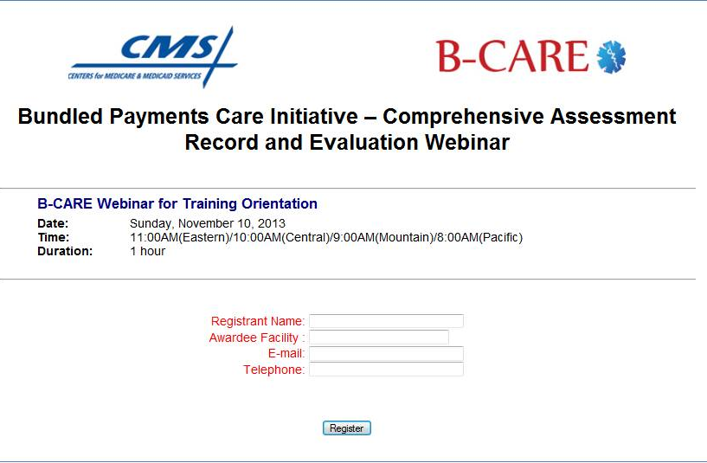
Webinar Registration

Slide 11
Webinar Registration
After registration, a confirmation email will be sent from the vendor: Webinars@ConferTel.net. Please note that the first email often arrives in your spam folder. If you have not received your confirmation email within 1 hour, please check there.
In the confirmation email, you will receive a personal PIN number, phone number, and webinar link to join the conference. This information is for individual use only and will only work when the designated registrant logs in. Please do not share this information with other attendees, or you will not be able to join.

Slide 12
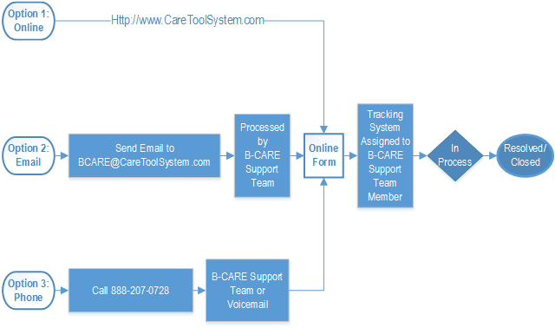
Help Desk Information

Slide 13
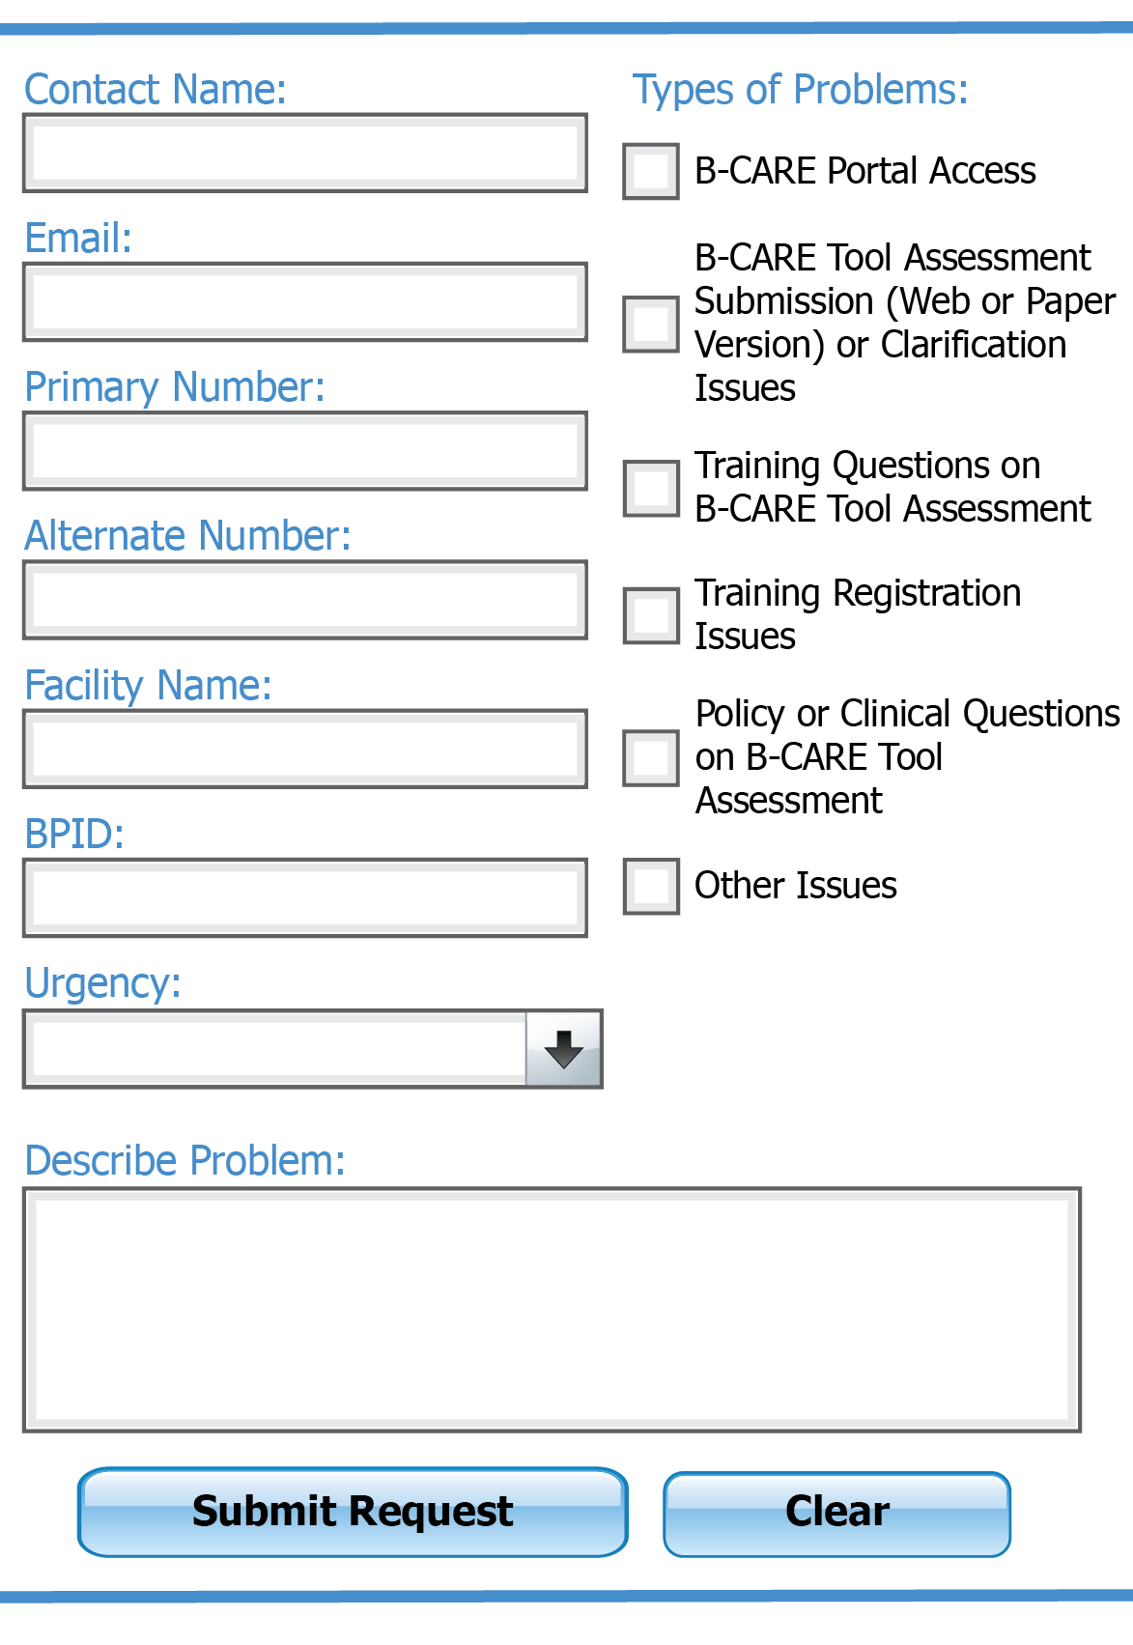
Help Desk Information
Trainers, B-CARE Coordinators, and End Users from any location can access the Help Desk, which will provide live staffing during business hours (8:00 a.m. to 8:00 p.m. EST) across the 10 CMS regions and a message box for awardees to leave questions after hours.

Slide 14
B-CARE Portal Registration Process
1
User completes Registration Part 1 to create user profile for Portal Access
2
CMS validates information in user profile is unique
3
User completes Registration Part 2 to create user name and password
User requests appropriate user role within B-CARE Portal
4
Approver* grants B-CARE user role to user
5
Ready for Go-Live on March 6, 2014!
* B-CARE Coordinators are approved by Master Trainers, B-CARE End Users are approved by their B-CARE Coordinator

Slide 15
B-CARE Assessment Tool Technical Information
Internet connectivity is required
Browser Requirement: Internet Explorer
Operating System Requirement: Microsoft Windows
Adobe Reader Requirement: Version 10 or higher

Slide 16
Closing

